Slide 1

Project on SPATIAL IMAGE CLUSTERING ANALYSIS
By
N. Pragna Patavi (08241A0582), Sambhavi. J(08241A0589),
G.Hema Latha(08241A05B7), Ramya Varanasi(08241A05B9)
Under the esteemed guidance of
Ch.Mallikarjuna Rao ,
Associate Professor
Department of Computer Science and Engineering
GOKARAJU RANGARAJU INSTITUTE OF ENGINEERING AND TECHNOLOGY

Slide 2
INTRODUCTION

Slide 3
DATA MINING?

Slide 4
SPATIAL DATA MINING?

Slide 5
SPATIAL DATA CLUSTERING?

Slide 6
DBSCAN

Slide 7
DBSCAN
DBSCAN is a density-based algorithm.
(Density Based Spatial Clustering of Application with Noise)
It takes two parameters:
Eps: Maximum radius of the neighborhood
MinPts: Minimum number of points in an Eps- neighborhood of that point
Density = number of points within a specified radius (Eps)

Slide 8
DBSCAN TERMINOLOGY
A point is said to be:
Core point:
It is a point inside the cluster i.e., a point having an Eps neighborhood not less that MinPts.
Border point:
It is a point which lies on the border of clusters. It has its Eps neighborhood less than MinPts.
Noise point:
It is any point that is not a core point or a border point.

Slide 9
Concepts: ε-Neighborhood
ε-Neighborhood - Objects within a radius of ε from an object. (epsilon-neighborhood)
Core objects - ε-Neighborhood of an object contains at least MinPts of objects
ε-Neighborhood of p
ε
ε
ε-Neighborhood of q
q
p
p is a core object (MinPts = 4)
q is not a core object

Slide 10
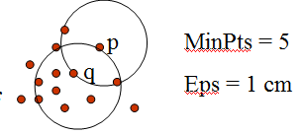
Directly density –reachable: A point p is directly density-reachable from a point q w.r.t. Eps, MinPts if
p belongs to N_{Eps}(q)
core point condition:
|N_{Eps} (q)| >= MinPts

Slide 11
Density-reachable:
An object p is density-reachable from q w.r.t ε and MinPts if there is a chain of objects p₁,…,p_{n}, with p₁=q, p_{n}=p such that p_{i+1}is directly density-reachable from p_{i} w.r.t ε and MinPts for all 1 <= i <= n
Two border points of same cluster are not density reachable from each other because the core point condition might not hold for both of them.
q is density-reachable from p.
q
p

Slide 12
Density-connectivity
Object p is density-connected to object q w.r.t ε and MinPts if there is an object o such that both p and q are density-reachable from o w.r.t ε and MinPts
P and q are density-connected to each other by r
Density-connectivity is symmetric.
q
r
p

Slide 13
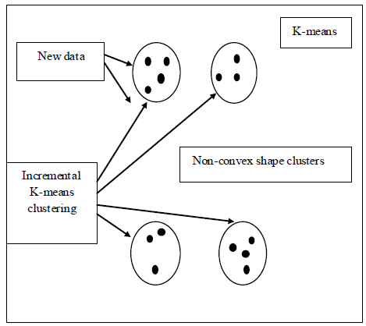
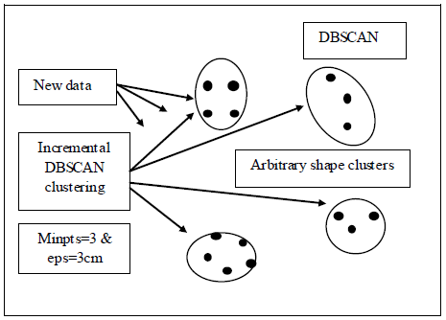
ADVANTAGES OF DBSCAN OVER K-MEANS

Slide 14
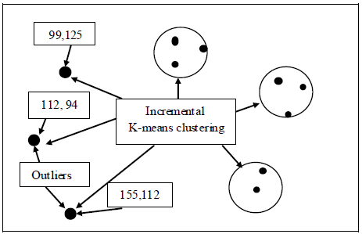
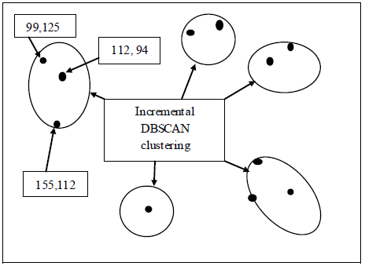
Predefined clusters numbers
Outliers handling

Slide 15
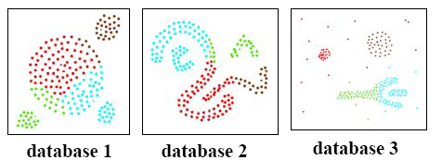
DBSCAN Vs CLARANS
Clusters discovered by CLARANS
Clusters discovered by DBSCAN

Slide 16
DBSCAN is more effective in discovering clusters of arbitrary shape than CLARANS.
DBSCAN can identify noise whereas CLARANS cannot.
Runtime of CLARANS is comparatively very large.
CLARANS cannot be applied for large databases.
Results show that DBSCAN outperforms CLARANS by a factor of at least 100 in terms of efficiency.

